Slide 1

MATRIX – UNIT 1
SEM 1 – BSCSIT

Slide 2
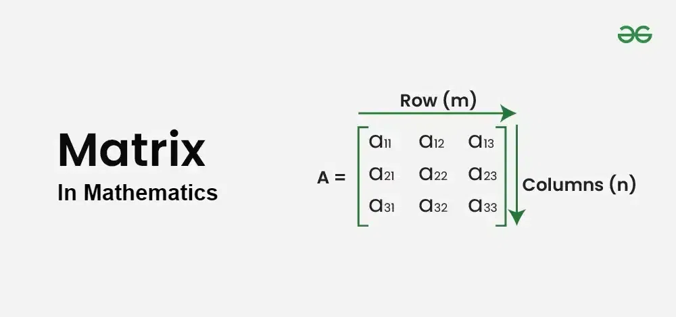
What is matrix ?
Matrix is a set of numbers arranged in rows and columns so as to form a rectangular array.
A – [ aij ]
I = Row = 1 2 ……. , m
J = column = 1 2……. , n
Order of matrix = m (row ) x n ( column )

Slide 3
Matrices are rectangular arrays of numbers arranged in rows and columns that can be used in many real-life applications:
Graphic representations: Matrices can be used to animate shapes and create graphs.
Robotics: Matrices can be used to program robots to perform tasks, such as a bionic arm that can mimic a human arm.
Security: Matrices can be used to encode data.
Economics and business: Matrices can be used to study business trends, create business models, and solve challenges like maximizing asset use.
Geology: Matrices can be used to conduct seismic surveys and create graphs and statistics.
Science: Matrices can be used in optics to account for refraction and reflection, in electrical circuits to solve AC network equations, and in quantum mechanics.
Health care: Matrices can be used to develop scans.
Gaming: Matrices can be used to alter objects in 3D space.

Slide 4
thank-you

